Slide 1
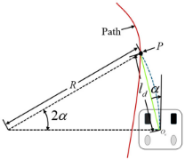
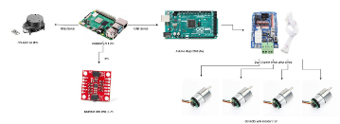

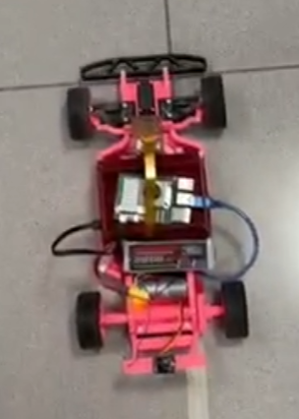
AUTONOMOUS VEHICLE NAVIGATION VIA DISTRIBUTED
ROS 2 ARCHITECTURE
Autonomous System (MCTR1002) | Project Poster | Team #18
Youssef Mohamed, Bassam Walid, Styven Hany, Somaya Magdy, Yassin Hesham, Mostafa Shakweer
ABSTRACT
STATE ESTIMATION & FILTERING
RESULTS & ANALYSIS
This poster presents a distributed autonomous vehicle architecture using a Sense-Plan-Act framework. Processing tasks are divided between a Raspberry Pi 5 (high-level ROS 2 trajectory & Pure Pursuit) and an Arduino Uno (low-level motor control & sensor polling). Digital filtration on raw encoders and MPU6050 IMU data mitigates noise, enabling stable navigation across Straight, Racing, and Curved track environments.
Digital Signal Filtration
Implemented first-order low-pass filters to isolate high-frequency mechanical noise and wheel slippage.
Euler-Based Dead Reckoning
METHODOLOGY: SYSTEM ARCHITECTURE
LATERAL CONTROL: PURE PURSUIT
The system calculates target curvature ( ) based on speed-scaled lookahead distance ( ):
Performance Metrics
Test Track | Peak Error | Velocity
Straight | < 0.045m | 0.146 m/s
Racing | < 0.034m | 0.185 m/s
City | < 0.052m | 0.185 m/s
Resulting Steering Angle ( ):
Distributed Framework
Smoothing is applied to eliminate mechanical jitter at 20 Hz via exponential decay.
SYSTEM PERFORMANCE
•
Raspberry Pi 5: Path planning, ROS 2 nodes, Pure Pursuit lateral control.
•
Arduino Uno: Low-level PWM regulation, interrupt-driven sensor sampling.
EXPERIMENTAL ENVIRONMENTS
•
Sensors: MPU6050 IMU (I2C), JGA-25-370 Encoders.
•
Straight Track: Longitudinal tracking at 0.8 speed to x=10m.
The unified hardware-stack successfully minimized cross-track errors and prevented boundary collisions across all trials.
HARDWARE INTEGRATION
•
Racing Track: Obstacle avoidance (waypoints at x=4m, 8m).
•
City Track: Complex loop with shifting road radii.
CONCLUSION
This project validates a dual-board architecture that eliminates processing bottlenecks. Future work will shift from geometric Pure Pursuit to Model Predictive Control (MPC), unlocking high-speed navigation in volatile environments by forecasting tire slip and physical constraints.
Figure 1: Vehicle Prototype

